Slide 1
E-retail factors for customer activation and retention: A case study from Indian e-commerce customers
Flip Robo Technologies

Slide 2
Agenda
Problem statement
Problem understanding
EDA STEPS and visualization
Assumption
conclusion

Slide 3
Problem statement
E-retail factors for customer activation and retention: A case study from Indian e-commerce customers
Customer satisfaction has emerged as one of the most important factors that guarantee the success of online store; it has been posited as a key stimulant of purchase, repurchase intentions and customer loyalty. A comprehensive review of the literature, theories and models have been carried out to propose the models for customer activation and customer retention. Five major factors that contributed to the success of an e-commerce store have been identified as: service quality, system quality, information quality, trust and net benefit. The research furthermore investigated the factors that influence the online customers repeat purchase intention. The combination of both utilitarian value and hedonistic values are needed to affect the repeat purchase intention (loyalty) positively. The data is collected from the Indian online shoppers. Results indicate the e-retail success factors, which are very much critical for customer satisfaction
Be careful: There are two sheets (one is detailed) and second is encoded in the excel file. You may use any of them by extracting in separate excel sheet. The number of column(s) is more than 47. Read the column header carefully.
Note : Data Scientists have to apply their analytical skills to give findings and conclusions in detailed data analysis written in jupyter notebook . Only data analysis is required.
Need not to create machine learning models /but still if anybody comes with it that is welcome.

Slide 4
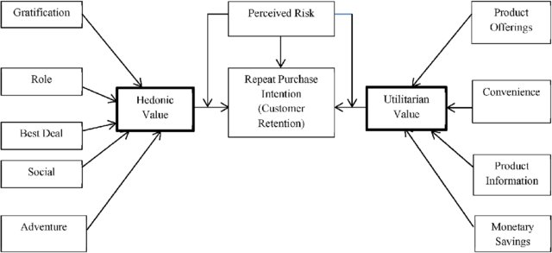
Customer retention chart

Slide 5
Problem understanding
What is Customer Retention?
Customer retention is a business’s ability to keep existing customers and continue to generate revenue from them. Companies use different tactics to convert first-time buyers into repeat shoppers. customer retention is focused on existing customers. The goal is to increase repeat purchases by building customer loyalty through excellent customer service, product value and a distinct advantage over similar products or services.
Benefits of Customer Retention
Increased profits
Lower costs
Increased average order value
Acquire brand ambassadors

Slide 6
Hedonic value: Hedonic value is defined as that value a customer receives based on the subject experience of fun and playfulness.
Utilitarian value: Utilitarian value is defined as that value that a customer receives based on a task-related and rational consumption behavior
There are two sheets (one is detailed) and second is encoded in the excel file. You may use any of them by extracting in separate excel sheet. The number of column(s) is more than 47. data is combination of Hedonic and Utilitarian

Slide 7
EDA Steps and Visualization
Import Libraries
Import Dataset
Data preprocessing
EAD
Visualization
Label encoding
Principal components analysis
Checking NaN and Dtypes

Slide 8
Data have 269 rows and 71 columns. Null values are not present in dataset it is good.
Data content User information, opinions about websites and website recommendation.
Removing tab spaces from columns / leading and ending spaces for better understanding.
After checking value count I found some duplicate entries in columns, that values replaced .
In EDA performed Univariate and Bivariate analysis by plotting charts like count plot, pie plot, with help of matplotlib and seaborn.

Slide 9
Gender and City
Female shop more than males
more than 50% of customers are from Noida , Greater Noida and delhi.

Slide 10
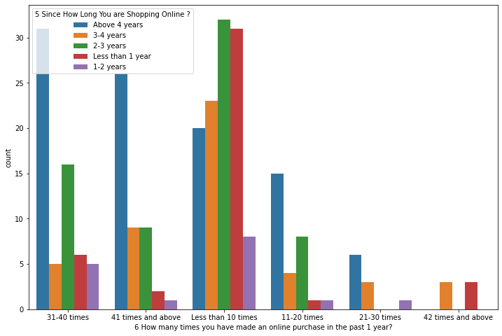
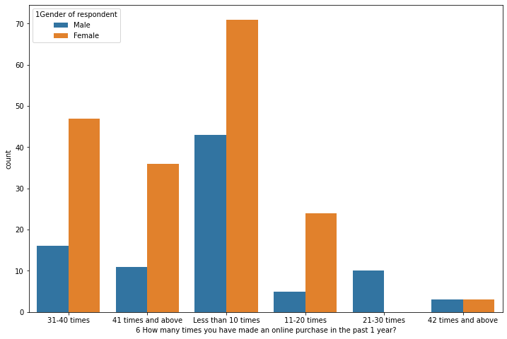
Purchase in past 1 year
most of customer buy online less than 10 times followed by 31- 40 times .
Customer who buy more from online shopping website since more than 1 year purchase as compare to new customers. Because they have trust and satisfied from services provided by shopping website.

Slide 11
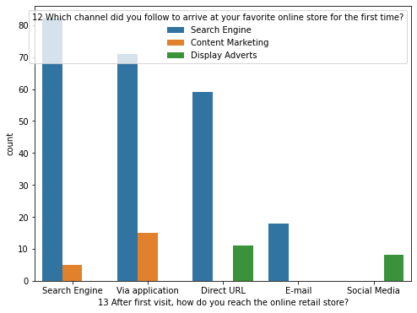
Customers device
Most of the customers used Smartphone device to access the online shopping and only few customers used Tablet to access the online shopping.
Most of the customers used Google chrome to access the website and only few of the customers used Opera and Mozilla Firefox to access the online shopping website. Most of the customers used Search Engine and Via application to reach the online retail store after their first visit and also some customers used Detect URL to reach the online store. Which means these customers have downloaded their most favourite application to reach the online stores easily.

Slide 12
Purchase Decision
Most customers explore the e-retail store more than 15 min before making a purchase decision irrespective to since how long they are shopping. Because customer searching for alternative product .
Before Buying any product customers compare product price in different online shopping sites for better deal.

Slide 13
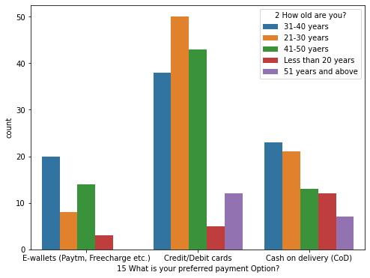
Payment options
Online shopping website have lots of payment option for there customers but there are some most use payment option are e-wallets, Credit/Debit card and cash on delivery(COD)
Most of customers use credit and debit card for payments. Customer age between is 21-50 years use credit and debit card for payment.
Other age group customer use Cash on Delivery and E-wallets for purchasing product online.

Slide 14
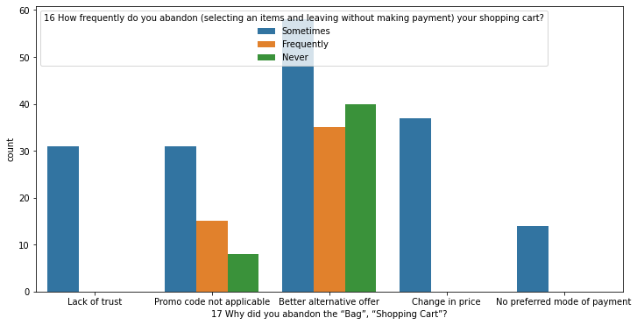
Abandon Cart
Sometimes Customers abandon there cart in online shopping website, customer searching for best deal where they save maximum money and lack of trust are main reason for abandon cart. Some customers say because of promo code is not applicable on selected product they abandon cart.

Slide 15
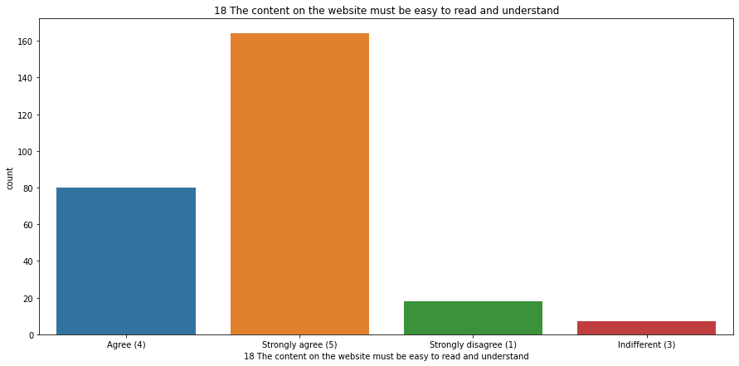
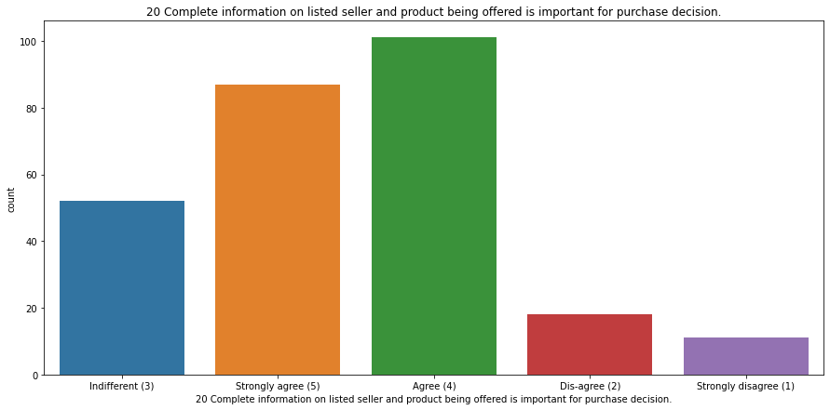
Product information
Easy to read and understand
Complete information
Most of customers agree on website content is must be easy to read and provide complete information about product.

Slide 16
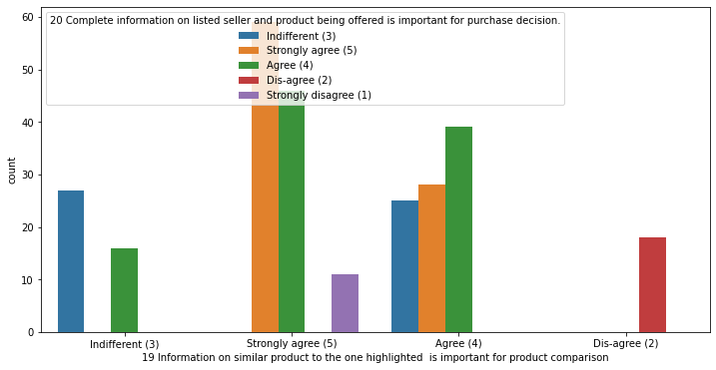
Most of the customers agreed that the information on similar product to the one highlighted is important for product comparison and also Complete information on listed seller and product being offered is important for purchase decision. In order to buy a product, the ecommerce website must give the complete information about the product and seller information then only the customers can compare the product costs and its details in different websites and they tend to buy that particular product in a particular website.

Slide 17
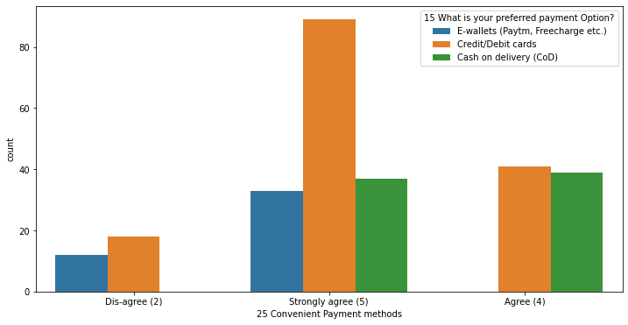
Most of the customers agree to the trust that the online retail stores will fulfil its part of the transaction at the stipulated time also most of them very happy with the convenient payment modes given by the websites. In other words, the websites must provide all the possible ways of payment methods then only the customers shop frequently all the time the mode of the payment for customers may not possible sometimes they may choose cash on delivery. so if the retailers provides all type of payment methods then the customers can easily make the payment also it enhances the sales of the ecommerce sites. And the transaction must also be given with some stipulated time otherwise the payments may be failed so they've to provide minimum amount of time which need to be fixed for all.

Slide 18
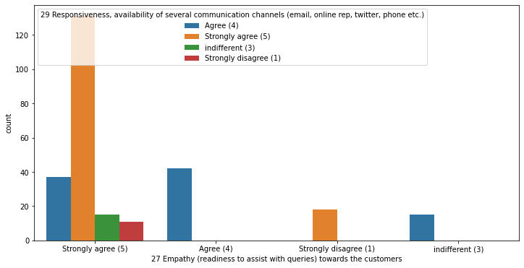
Almost all the customers agreed that ecommerce websites have empathy towards them and these sites being able to guarantee the privacy of the customers. That is the online retailers must be able to resolve all the queries of the customers and they have to assure the customers keeping all their credential secured and should not share with others. If the websites give guarantee about the privacy, then the customers make shopping regularly which will enhance the company sales.

Slide 19
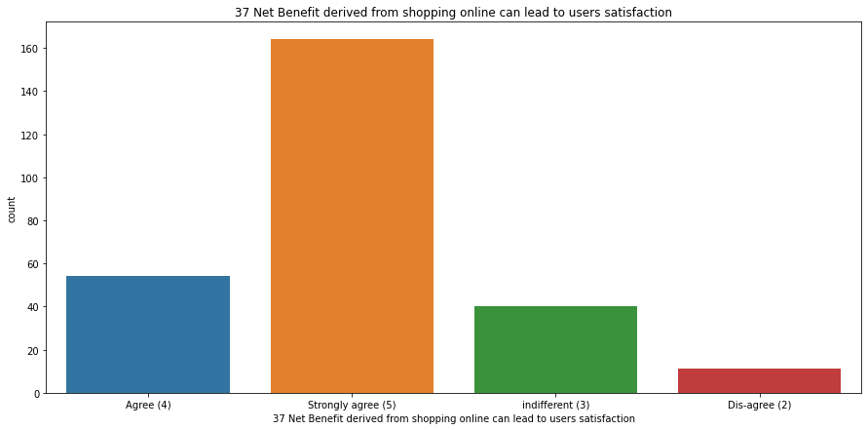
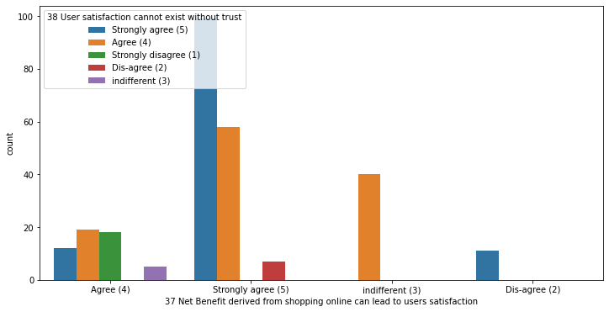
Convenience, Better Prices, more variety and payment options in combined make net benefits. If customer getting more benefits from online shopping that lead customer satisfaction. If customer satisfied by online shopping then online shopping website make trust in customers mind.

Slide 20
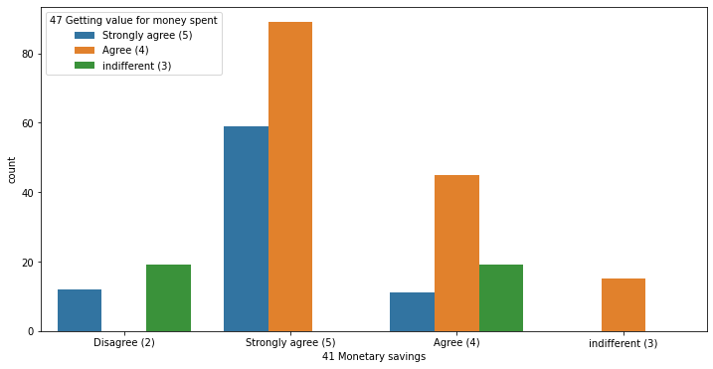
Most of the customers agreed that the online shopping gives monetary benefits and Getting value for money, if one website gives less price and more discount for particular product then the customers tend to shop more in that particular website. So the companies must try to give less price then customers like their offers and retention also increases. Most of customers thinks that online shopping gives monetary benefits and discount. Customers Satisfaction is dependent on Monetary saving, satisfied customers make more purchase.

Slide 21
Important Observation
Data content User information, opinions about websites and website recommendation.
Content of the website must be easy read and easy to understand.
Payment methods must be convenient for customer retention.
Customers Satisfaction is dependent on Monetary saving.
user friendly interface and complete information help in purchase decision.
net benefits, return and replacement policy and convenient payment method are important for customers satisfaction.
Gain trust in customers mind is also important for retention of customers.

Slide 22
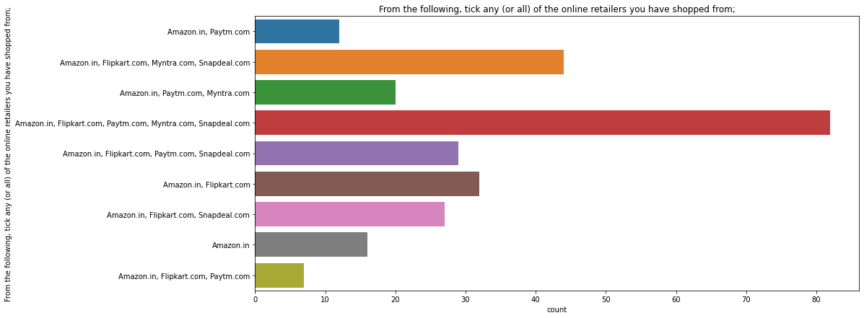
Amazon.in, Flipkart.com, Paytm.com, Myntra.com, Snapdeal.com are most commonly use website in customers.

Slide 23
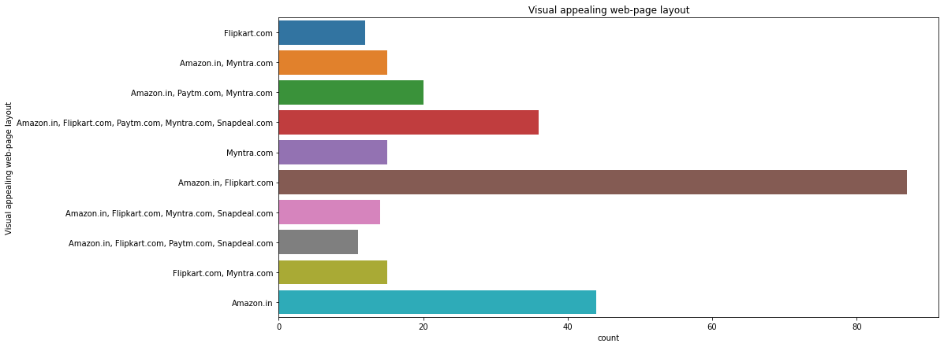
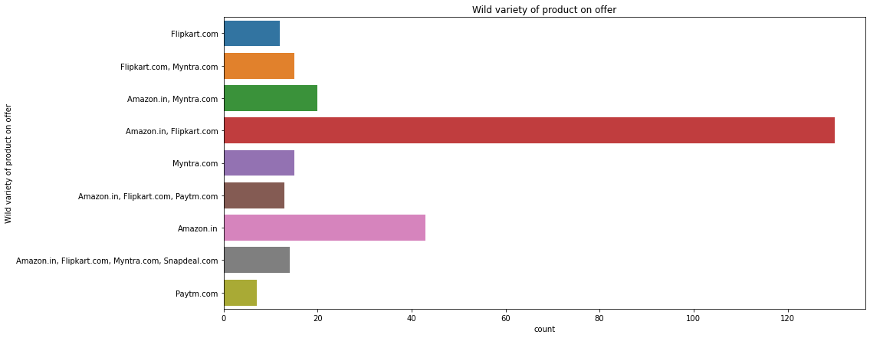
Visually appealing web page
Wild variety of product
Visually appealing website are uses clean layout and provide complete information. Providing wild variety of product lead to more customer retention because customers find all desired product they shop from same website again and again.

Slide 24
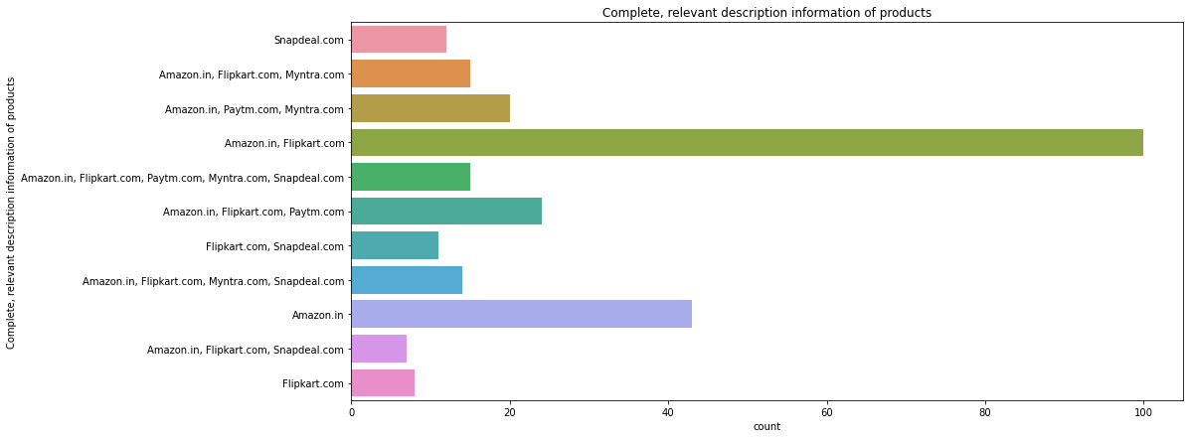
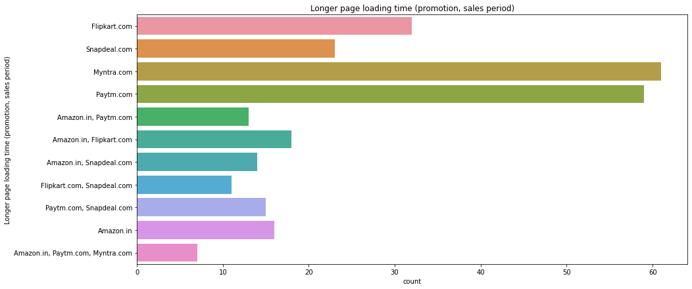
Provide complete information
Longer page loading time
only few websites provide the relevant information about the products. amazon and flipkart websites gives complete and relevant information and these websites have no issue with the server and most of the customer liked the web speed of both amazon and flipkart.

Slide 25
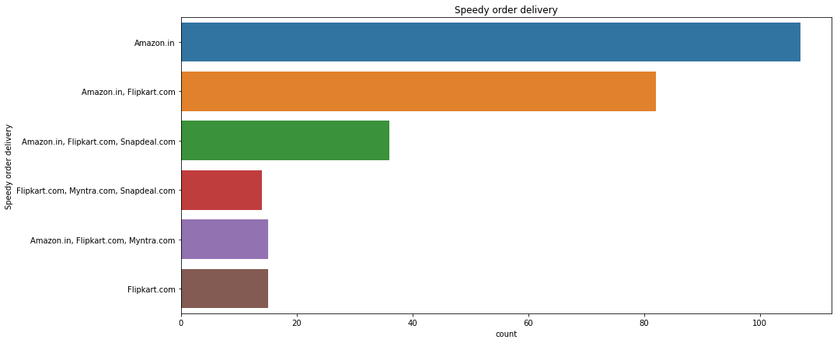
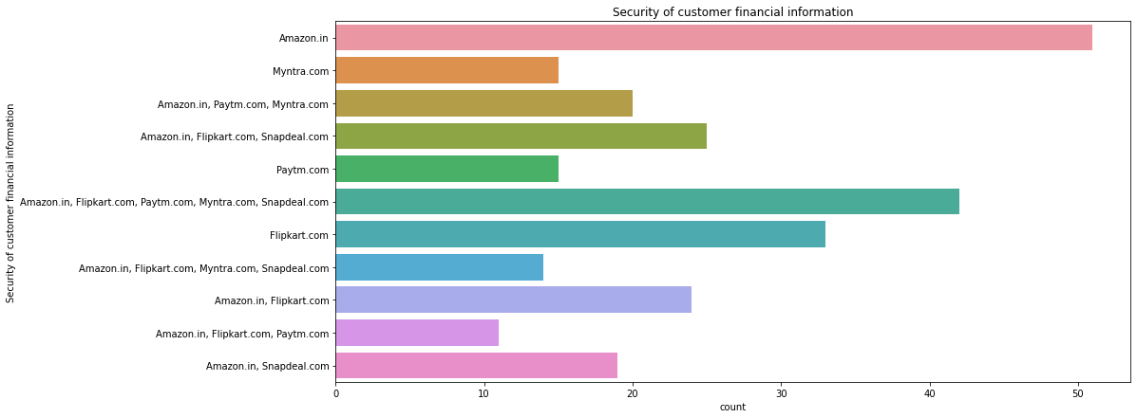
Delivery speed
Customer Privacy
amazon has speedy order delivery compared to other websites.
Most of the customers trusts amazon followed by flip kart in terms of keeping their privacy of data information secured.

Slide 26
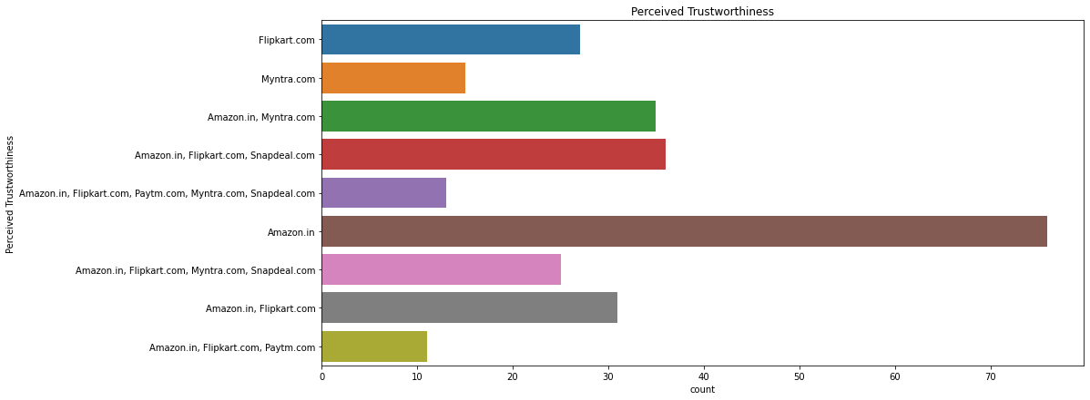
Most of the customers trusts amazon followed by flip kart in terms of keeping their privacy of data information secured and the customers who believes that amazon website keeps their financial information as secrete also trusts flip kart, Myntra, Snapdeal and Paytm in terms of keeping their financial information secured. Most of the customers believed that Amazon has perceived trustworthiness compared to others. Apart from this, customers believed that flip kart and Myntra also have perceived trustworthiness.

Slide 27
Conclusion
Customer retention is a business’s ability to keep existing customers and continue to generate revenue from them.
After the analysis all the data consumer retention is dependent on various variable. Consumer make purchase decision on price, discount, delivery time, payment options and trust on shopping website. Return and replacement policy can effect the customers decision to by that product.
Customer satisfaction is also important customer retention. Customer satisfaction is dependent on serval factor like convenience, empathy toward customers, quick resolving customers problem, getting value for money, net benefits and many more. If online shopping website fill all this factors and provide best service to customer there big chance of getting customer retention at high rate of percentage.
Privacy of customers and financial information is major factor that customers worried, if gain trust in customer mind about there data privacy can be good.

